Slide 1
House Buying Recommendation System
Gangyu Pan

Slide 2

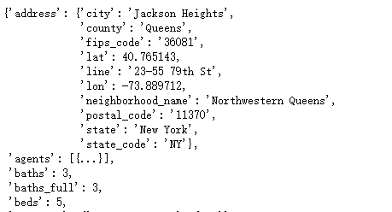
Project Description
Datasets:
Realtor API(Basic Info)
Crimeometer API
School district Room,etc.
Upload to Firebase
Spark process data

Slide 3


Show data and search
House Buying Recommendation System
Choose
Search
House ID | Location | Zipcode | Price | Crime Score | SDR
… | … | … | … | … | …

